Slide 1

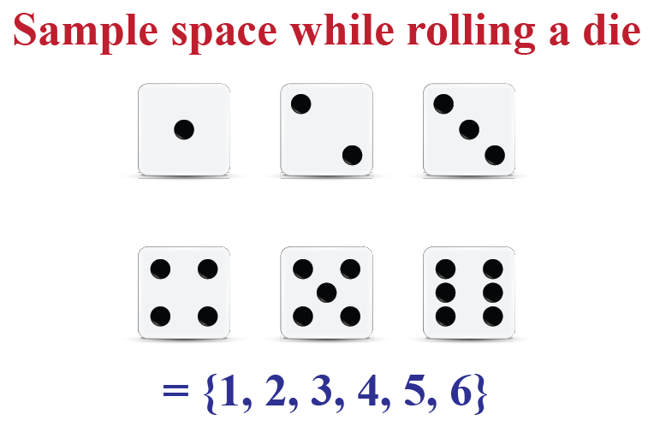

Independent Events
If P(A) ≠ 0 and P(B) ≠ 0
then mutual exclusivity
implies dependence,
because
P(A∩B) = 0 ≠ P(A)*P(B)
Mutually Exclusive Events
Knowing that A happens doesn’t change probability that B happened
P(A|B) = P(A) (given that P(B) ≠ 0)
A and B cannot occur together
P(A∩B) = 0
A and B have no intersection
The occurrence of event A doesn’t affect the occurrence of event B
P(A∩B) = P(A)*P(B)
 | A |  |  |  | B
E.g. – rolling two dies:
Event A: rolling 6 with first die
Event B: rolling 1 with second die
Dependent Events
P(A∩B) = P(B) * P(A|B)
E.g. – rolling two dies:
Event A: rolling 6 with first die
Event B: rolling 11+ total with both dies
Event A -> P(A) = 1/6
Event B -> P(B) = 3/36
E.g. – rolling one die:
Event A: rolling 6
Event B: rolling 1
Universe #1
Universe #2
Universe #3
Event A∩B -> P(A∩B) = 2/36
Universe #1
Universe #2
Universe #1
P(A) = 1/6
P(B) = 1/6
P(A∩B) = 1/36 = P(A) * P(B)
Universe #2
P(A∩B) = 2/36 ≠ P(A) * P(B) = 3/216
P(A∩B) = P(B) * P(A|B) = 1/6 * 2/6 = 2/36

Slide 2
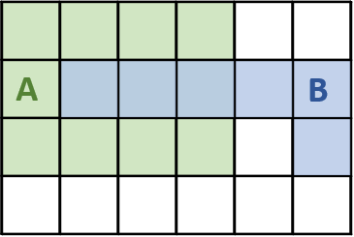
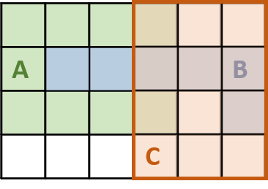
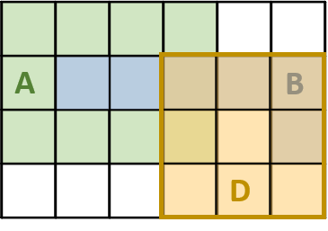
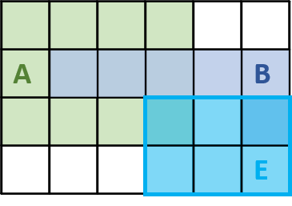

Independence
Conditional Independence
Conditional Probability
P(A|B) = P(A) (given that P(B) ≠ 0)
P(A | B∩C) = P(A | C)
Conditional probability answers the question:
“What is the chance of event A happening,
Given that I have already observed event B?”
P(A∩B) = P(A)*P(B)
P(A∩B | C) = P(A | C) * P(B | C)
 |  |  | A
 |  |  |  | B
Let’s assume events A and B are independent ->
-> P(A∩B) = 3/24 = 1/8 =
= P(A)*P(B) = 12/24 * 6/24 = 1/8
P(A|B) = $\frac{\text{P}\text{(}\text{A}\text{∩}\text{B}\text{)}}{\text{P}\text{(}\text{B}\text{)}}=\frac{\text{2}}{\text{8}}$
The illustration from above is valid
for situation when A and B are dependent
as well as when they are independent
P(A∩B | C) = 1/12
P(A∩B | D) = 1/9
P(A∩B | E) = 0
P(A | C) * P(B | C) =
3/12 * 4/12 = 1/12
P(A | D) * P(B | D) =
2/9 * 4/9 = 8/81
P(A | E) * P(B | E) =
1/6 * 1/6 = 1/36
A and B are conditionally
independent given C
A and B are NOT conditionally
independent given C
A and B are NOT conditionally
independent given C
Independence relations can change with conditioning

Slide 3
misc
 |  |  | A
 |  |  |  |  |  | D
 |  |  |  | B
 |  |  | A
 |  |  |  | B |  | C
 |  |  | A
 |  |  |  | B
E
C
A
 |  |  |  |  | B
A
 |  |  |  |  | B
 | D
A
 |  |  |  |  | B
 |  | E
A
 |  |  |  |  | B
A
 |  |  |  |  | B

